Slide 1




Designing Cloud Servers for Lower Carbon
Jaylen Wang, Daniel S. Berger, Fiodar Kazhamiaka, Celine Irvene, Chaojie Zhang, Esha Choukse, Kali Frost, Rodrigo Fonseca, Brijesh Warrier, Chetan Bansal, Jonathan Stern, Ricardo Bianchini, Akshitha Sriraman
ISCA’24
Notes:
Before I start – I’d like to ask everyone in the audience to take a seat if you agree that lowering the carbon emissions of the cloud is important… clearly you all agree with me, except for you, we’ll have to talk later (point to someone standing off to the side)… but now I’m even more excited to
be presenting to you how significantly greener clouds are possible with green server design – this is work done in collaboration with Microsoft Azure where

Slide 2
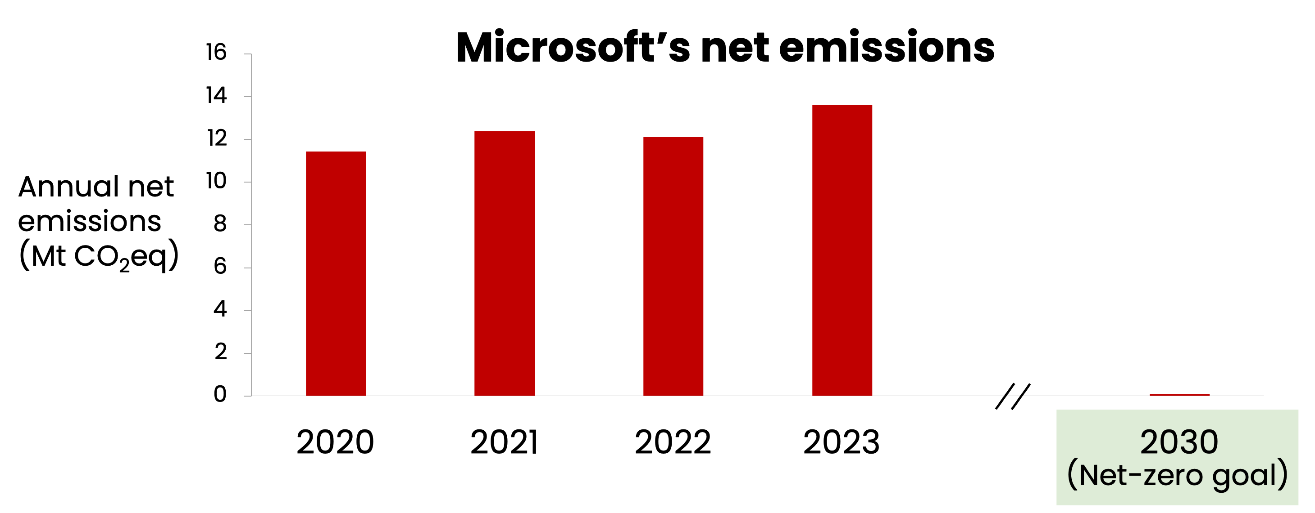
Cloud computing’s carbon conundrum
Mismatch
“The rise in our […] emissions primarily comes from the construction of more datacenters…”
[Microsoft Sustainability Report ‘24]
Cloud demand is growing, but cloud carbon reductions are not keeping pace
Notes:
our motivation is that cloud computing has a carbon conundrum, in that the emissions of major cloud providers, such as Microsoft, have been on the rise, which is a mismatch for achieving their crucial, quickly approaching net zero goals. And it’s been reported this rise in emissions primarily stems from the increased need for data centers, pointing out that cloud demand is growing but carbon reductions are not keeping pace.

Slide 3





Where do carbon emissions come from in the cloud?
Cloud computing causes two types of emissions:
Operational
Embodied
52%
48%
Compute servers cause over 70% of operational and 40% of embodied emissions
To reduce both types of emissions, it is crucial to lower the emissions of compute servers
Notes:
So then where do emissions come from within data centers?
Their emissions come from two types
The first type being operational emissions, which are those stemming from the power consumption of hardware.
The second, subtler type, is embodied emissions, which is the one-time emissions cost of manufacturing the hardware and the data center building itself.
We find at Azure that in today's data centers the split between the two is roughly 50/50.
Going one level deeper, compute servers, as opposed to storage or networking servers, within data centers make up over 70% of operational and 40% of embodied emissions.
So, to reduce both types of emissions we must lower the emissions of such compute servers

Slide 4

Why are compute servers carbon-inefficient today?
One reason: compute servers are underutilized:
Memory Bandwidth
CPU
Server Capacity
Utilized
Allocated
Designing servers for higher performance loses out on potential carbon savings
There are opportunities to design lower-carbon servers or GreenSKUs
Notes:
So why are compute servers carbon-inefficient today?
We find that compute servers are often underutilized
Where if looking at a common resource such as CPU, some amount of it on a server is allocated on average to virtual machines (or VMs) and then a small portion of that is actually utilized.
This also holds for other resources such as memory bandwidth.
Thus, designing for ever increasing performance loses out on potential carbon savings
But, by taking advantage of this underutilization, there are opportunities to design lower carbon servers or GreenSKUs (where a SKU is a stock keeping unit, or server design)

Slide 5
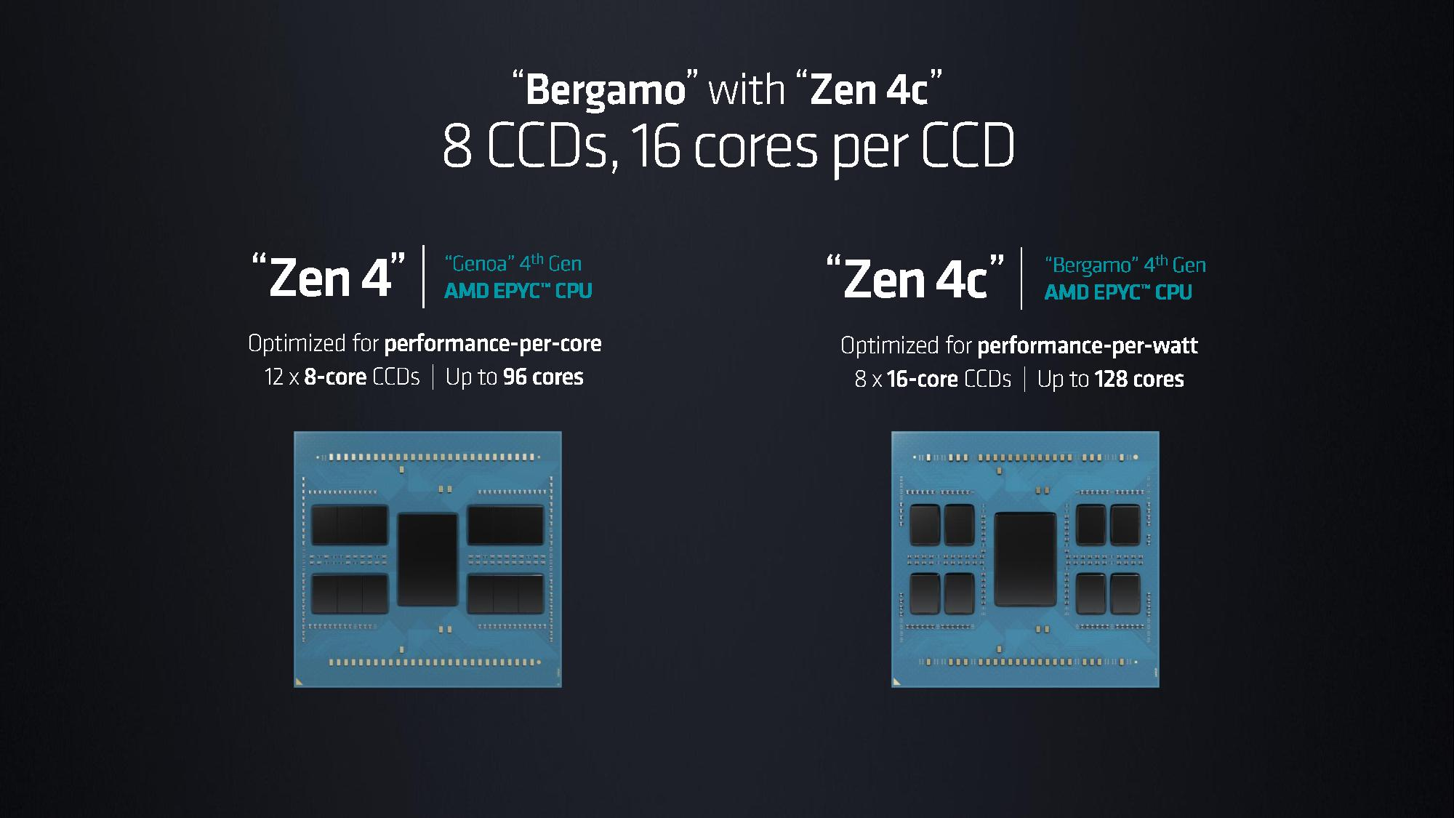
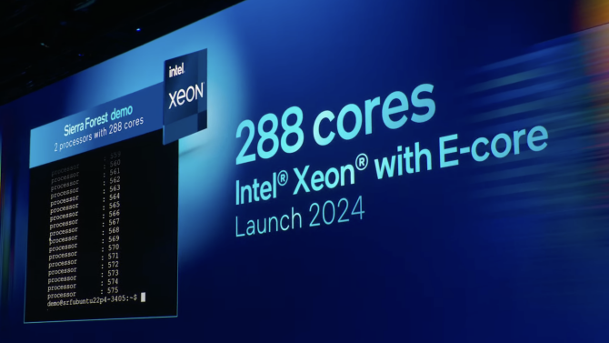


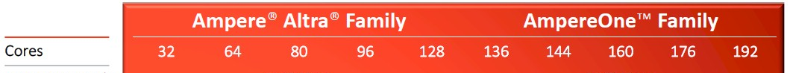
What are the opportunities for designing GreenSKUs? Why now?
Efficient CPU cores
Memory reuse through Compute Express Link (CXL)
SSD reuse through PCIe backwards compatibility
There’s a recent availability of lower-carbon compute server components
Notes:
So then what are the opportunities for designing GreenSKUs and why should we do this now?
We find that there are lower carbon server components that are now deployable
One example is efficient CPUs, where instead of what we traditionally use in the blue, where cores are high-performance, large, and power hungry, we opt for cores that are smaller and more energy efficient, which primarily reduces operational emissions. Vendors such as AMD, Intel, and Ampere have all recently released such efficient options.
Beyond operational emissions, there are also recent optimizations to reduce embodied emissions, such as extending the lifetime of DRAM by attaching DIMMs from decommissioned servers through compute express link (CXL), which allows for backwards compatibility.
This reuse, and reduction of manufacturing emissions from new hardware, can also be done for SSDs by taking advantage of PCIe’s backwards compatibility.
In total, we find that there’s a recent availability of these lower-carbon compute server components.

Slide 6






But, it’s challenging to deploy GreenSKUs at scale…
E.g., lower-carbon components may not meet an application’s performance goals
High-performance core
Efficient core
❌
Meeting perf. goals
Not meeting perf. goals
Cloud deployment:
Limited carbon savings
Once we design a GreenSKU, we need a systematic way to see if it’s worth it to deploy
Notes:
However, we can’t just naïvely deploy GreenSKUs as there are practical challenges to doing this at scale.
For example, we may not be able to meet performance goals due to carbon efficient components.
To illustrate, users running applications in the cloud may have the choice between
the traditional high-performance offering
along with a lower performance GreenSKU offering using an efficient CPU.
However, even though users may save carbon on the GreenSKU they may not meet their performance goals
and so few opt to use it.
This then results in a cloud deployment where, due to demand, most servers will need to have the high-performance core, limiting the practical savings of the GreenSKU.
This just shows that once we design a GreenSKU, we still need a systematic way to understand if it’s worth it to deploy

Slide 7





Our contributions
A real GreenSKU server design and implementation
A framework to evaluate a GreenSKU’s carbon-saving potential at scale
A carbon evaluation of our GreenSKU under Azure’s production constraints
Notes:
This leads to our contributions, where we first design and build a GreenSKU.
Then to evaluate our and future GreenSKUs’ potential to save carbon at scale, we develop a framework
Which we then implement and use to evaluate our designed GreenSKU in terms of data center carbon savings at Azure

Slide 8
Our contributions
A real GreenSKU server design and implementation
A framework to evaluate a GreenSKU’s carbon-saving potential at scale
A carbon evaluation of our GreenSKU under Azure’s production constraints
Notes:
So starting with our server design

Slide 9
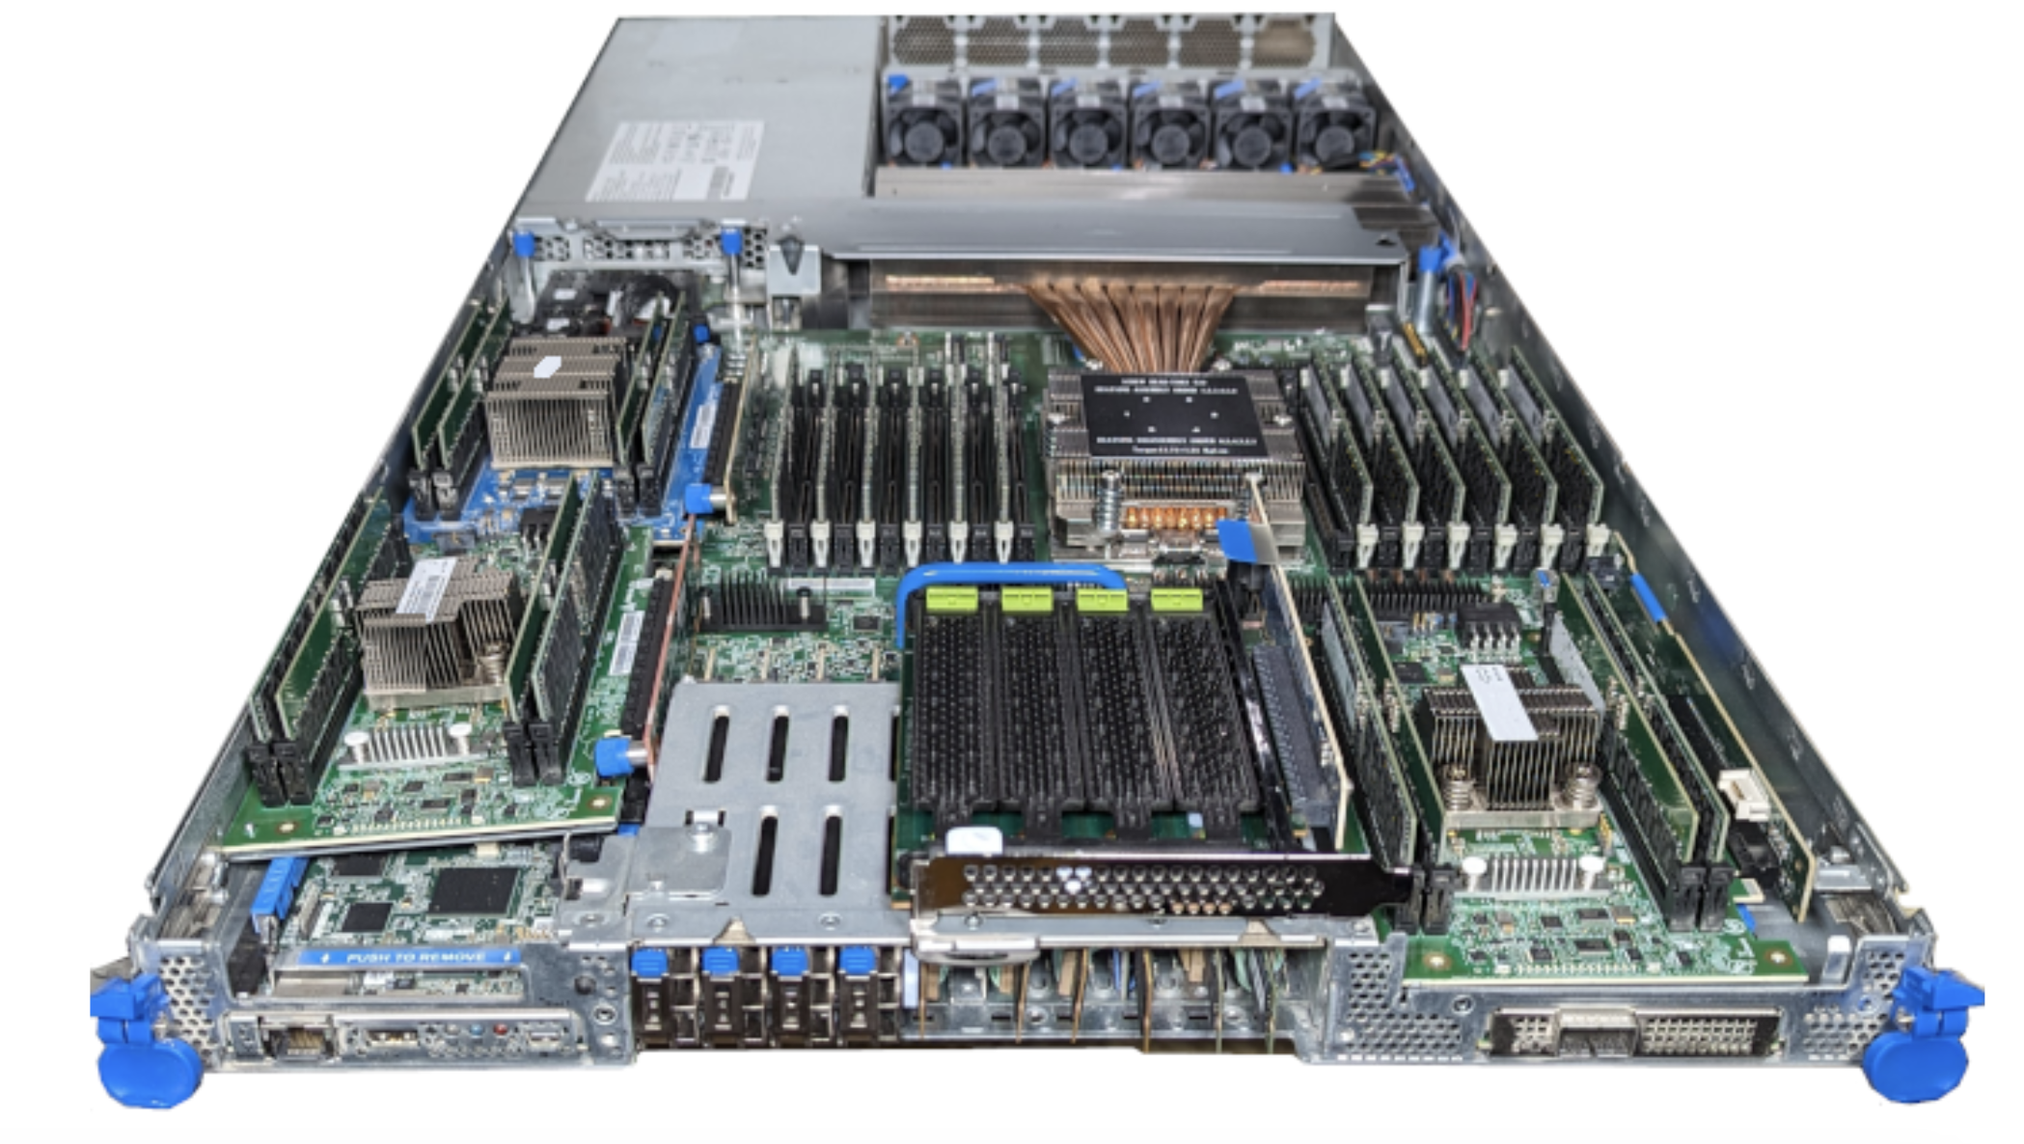
Our GreenSKU server design
We leverage recent carbon-efficient components to design and build our GreenSKU
(1) Efficient CPU
(2) Reused memory
(CXL-attached)
(3) Reused SSD
Notes:
We leverage the recently available carbon optimizations I mentioned previously.
Here is a photo of the server once built which includes an efficient CPU
Reused DDR4 memory attached through CXL
And reused SSD
Once built we then needed to understand, prior to deployment, its potential to achieve carbon savings at scale

Slide 10
Our contributions
A real GreenSKU server design and implementation
A framework to evaluate a GreenSKU’s carbon-saving potential at scale
A carbon evaluation of our GreenSKU under Azure’s production constraints
Notes:
Which leads to our framework

Slide 11
What is the framework’s high-level goal?
# of GreenSKUs in data center
GreenSKU Framework
GreenSKU design
Notes:
Which takes as input a GreenSKU design
And produces as output the number of GreenSKUs that can be deployed in a data center

Slide 12










What is the framework’s high-level goal?
Growth Buffer
Cluster Sizing
# of GreenSKUs in data center
Data center-level
Adoption
VM Allocation
Cluster-level
Performance
Maintenance
Server-level
GreenSKU Framework
GreenSKU design
Notes:
The framework achieves this through a set of components, as shown. And while there’s a lot going on, I don’t want you to get bogged down in the details,
just know that each component factors in a practical constraint that limits the number of GreenSKU’s you can deploy.

Slide 13


How do we determine a GreenSKU’s carbon savings?
Growth Buffer
Cluster Sizing
# of GreenSKUs in data center
Data center-level
Adoption
VM Allocation
Carbon Model
Cluster-level
Performance
Maintenance
Data center carbon savings
Server-level
GreenSKU Framework
GreenSKU design
Notes:
What we want finally though, is data center carbon savings, so to translate the number of deployable GreenSKUs to carbon savings,
we develop an open-source carbon model
that outputs how much carbon we can save through a GreenSKU deployment at scale.

Slide 14




How does a GreenSKU’s performance impact its adoption?
Growth Buffer
Cluster Sizing
Data center-level
Adoption
VM Allocation
Cluster-level
Performance
Maintenance
Server-level
GreenSKU Framework
GreenSKU design
Notes:
For this presentation I’ll focus on two components in particular, outlining how our framework goes about answering the question of how a GreenSKU’s server-level performance impacts its cluster-level adoption, where adoption captures which applications are suitable to run on a GreenSKU.

Slide 15
How do we measure a GreenSKU’s performance?
Performance
Server-level
*a high-performance deployed SKU without any GreenSKU optimizations
Baseline SKU*
GreenSKU
?
Meeting perf. goals
xapian
Meeting perf. goals?
Notes:
To answer this, we must first answer how we measure a GreenSKU’s performance.
To do this, let’s return to the previous situation where an application, let’s say Xapian which is an open source search application,
currently runs in the cloud on a Baseline SKU, which we define as a high-performance deployed SKU without any GreenSKU optimizations.
And because it’s running on the baseline SKU we can assume it’s meeting its performance goals.
What we want to see is if Xapian runs on a GreenSKU will it still be able to meet these performance goals.

Slide 16



How do we measure a GreenSKU’s performance?
Performance
Server-level
*a high-performance deployed SKU without any GreenSKU optimizations
xapian
Performance:
Baseline SKU
Baseline SKU*
GreenSKU
8 cores
is better
?
Tail Latency
Meeting perf. goals
xapian
Meeting perf. goals?
Service Level
Objective (SLO)
Load (QPS)
Notes:
The first step towards answering this is determining what the performance goals actually are.
To do this we benchmark the performance metric of note, which, as Xapian is an online service, is tail latency, where lower is better, and on the x-axis we vary the input load in queries per second.
We then run Xapian on the Baseline SKU using a nominal set of cores, here 8 cores.
Based on this we can then set a Service Level Objective or SLO which defines the performance goal as achieving some tail latency at some load.

Slide 17



How do we measure a GreenSKU’s performance?
Performance
Server-level
*a high-performance deployed SKU without any GreenSKU optimizations
xapian
Performance:
Baseline SKU
GreenSKU
Baseline SKU*
GreenSKU
8 cores
8 cores
is better
?
Tail Latency
10 cores
Meeting perf. goals
xapian
Meeting perf. goals?
❌
Service Level
Objective (SLO)
Load (QPS)
Notes:
With the performance goal quantified, we can then see if the GreenSKU meets this goal.
We do this by running the benchmark on the GreenSKU also with 8 cores.
Here we find that it does not meet the SLO.
To then meet the SLO we then scale up the cores on the GreenSKU until it is met, which in this case is at 10 cores.

Slide 18
How do we measure a GreenSKU’s performance?
Performance
Server-level
*a high-performance deployed SKU without any GreenSKU optimizations
xapian
Performance:
GreenSKU
Baseline SKU
GreenSKU
Baseline SKU*
+25% cores
8 cores
8 cores
is better
Tail Latency
10 cores
Meeting perf. goals
xapian
Meets perf. goals
❌
Service Level
Objective (SLO)
Load (QPS)
We identify the # of GreenSKU cores needed to achieve the baseline SKU’s performance
Notes:
- With this approach we can identify the number of GreenSKU cores, which in this case is an additional 25%, needed to meet the performance goals as defined by the Baseline SKU.

Slide 19
When should an application adopt a GreenSKU?
Growth Buffer
Cluster Sizing
Data center-level
Adoption
VM Allocation
Cluster-level
Performance
Maintenance
Server-level
GreenSKU Framework
GreenSKU design
Notes:
While we now understand how we can meet performance goals for Xapian, we still don’t know if, after potentially scaling up resources on the GreenSKU, we’re saving carbon,

Slide 20
When should an application adopt a GreenSKU?
Performance
Adoption
# GreenSKU cores (10)
# Baseline cores (8)
x
x
Cluster-level
Carbon Model
GreenSKU CO₂e per core
Baseline CO₂e per core
=
=
?
GreenSKU
application carbon
<
Baseline SKU
application carbon
Yes
No
Adopt
=
run on GreenSKU
with VM scaling factor (10/8)
Don’t adopt
=
run on Baseline SKU
with no VM scaling
We run an application on the GreenSKU if it meets performance goals and saves carbon
Notes:
so to account for this,
the adoption component uses the output from the performance component,
which is the number of GreenSKU cores.
Then we take the output from our carbon model
Which is the amount of carbon emitted per GreenSKU core.
Multiplying these values together gives the GreenSKU’s application carbon, which is the amount of carbon emitted to run Xapian on the GreenSKU.
We then calculate the same value for the baseline SKU,
allowing us to compare the two. If the GreenSKU’s carbon is lower,
we conclude that Xapian should adopt and run on the GreenSKU, as we know we’re meeting performance goals and savings carbon.
However, if the GreenSKU does not lower carbon, Xapian should not adopt the GreenSKU and run on the Baseline SKU as usual.
Thus, through the adoption component, we run an application on the GreenSKU if it meets performance goals and saves carbon.
Xapian is only one application, though, so we

Slide 21






We study our GreenSKU’s potential across Azure’s applications
Growth Buffer
Cluster Sizing
Data center-level
Adoption
VM Allocation
Web App
Web Proxy
Machine Learning Inference
Cluster-level
Performance
Maintenance
Big Data
DevOps
Real-Time Communication
Server-level
GreenSKU Framework
GreenSKU design
Notes:
we repeat this process across a set of Azure’s applications, as shown, to achieve a more representative view.

Slide 22
What else impacts a GreenSKU’s carbon saving potential?
Growth Buffer
Cluster Sizing
Data center-level
Adoption
VM Allocation
Cluster-level
Performance
Maintenance
Server-level
GreenSKU Framework
GreenSKU design
Notes:
Again, there are many other aspects of GreenSKU deployment

Slide 23
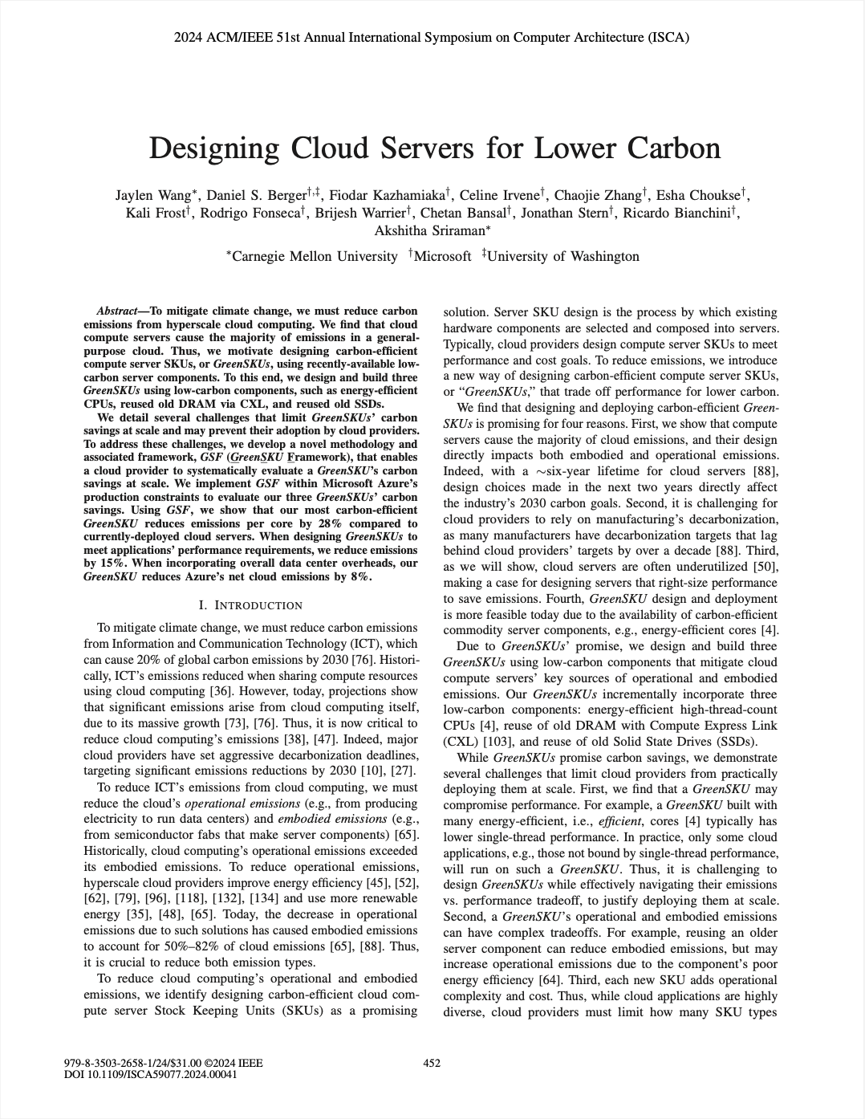



What else impacts a GreenSKU’s carbon saving potential?
Growth Buffer
Cluster Sizing
Data center carbon savings
Data center-level
Adoption
VM Allocation
See the paper!
Cluster-level
Performance
Maintenance
Server-level
GreenSKU Framework
GreenSKU design
Notes:
that we thoroughly outline in the paper, so I urge you to check it out. When taken together, though, the framework produces that final output that we need, data center carbon savings.

Slide 24
Our contributions
A real GreenSKU server design and implementation
A framework to evaluate a GreenSKU’s carbon-saving potential at scale
A carbon evaluation of our GreenSKU under Azure’s production constraints
Notes:
which we can use to evaluate our GreenSKU design

Slide 25
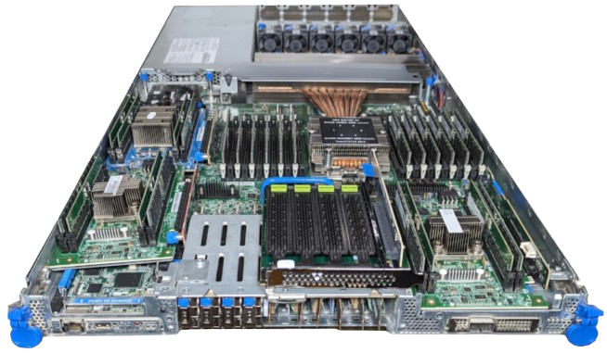


Evaluating two of our GreenSKU designs…
Growth Buffer
Cluster Sizing
Data center carbon savings
Data center-level
Adoption
VM Allocation
GreenSKU-Efficient
1
Efficient CPU
+ new DRAM/SSD
Cluster-level
Performance
Maintenance
2
GreenSKU-Full
Efficient CPU
Reused DRAM
Server-level
GreenSKU Framework
Reused SSD
Notes:
To understand the tradeoffs of different GreenSKU designs, we actually evaluate two designs
The first design, GreenSKU-Efficient, contains the efficient CPU with new DRAM and SSD, thus this design mainly saves operational emissions.
The second design, GreenSKU-Full, adds on reused DRAM and SSD along with the efficient CPU. Thus this design mainly targets embodied emissions.
For each we measure the resulting emissions.

Slide 26

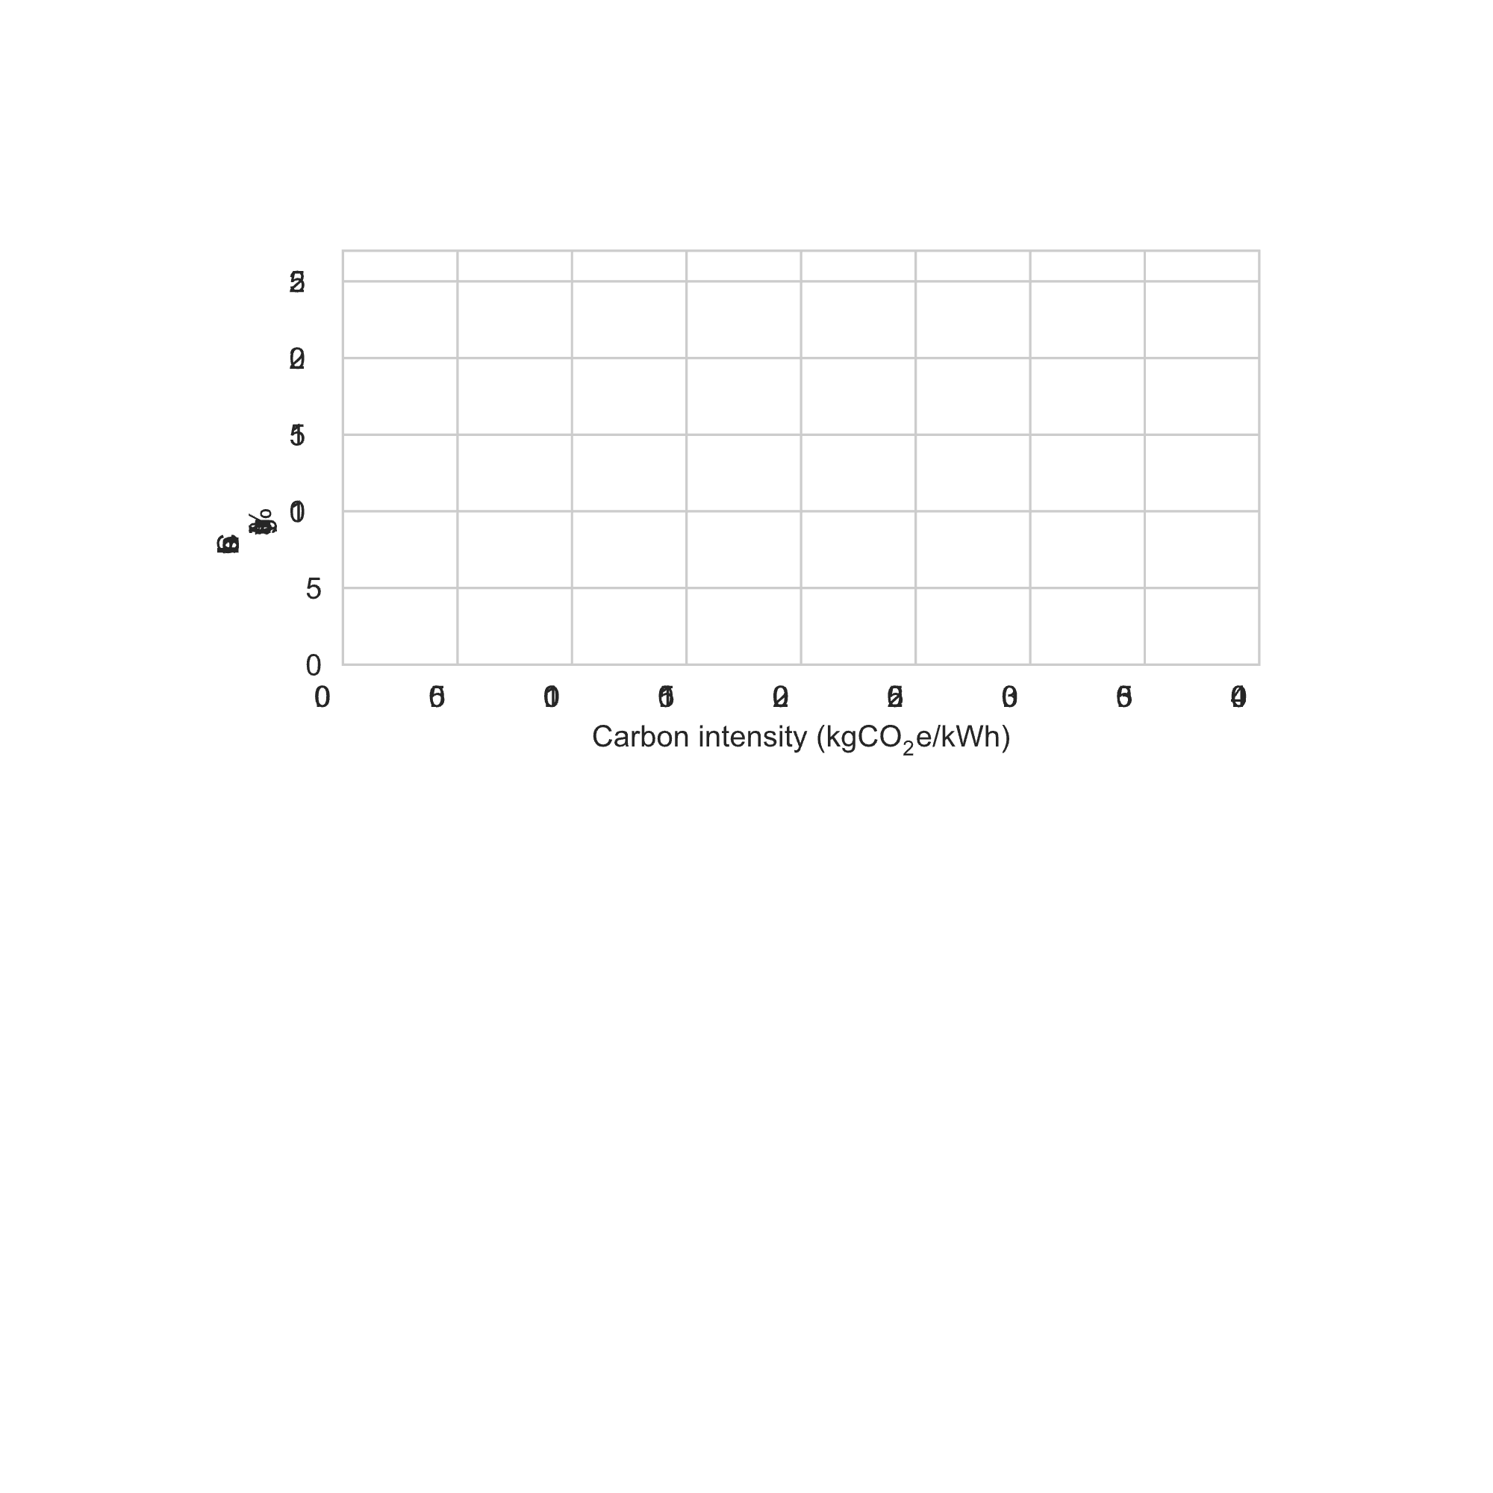

How much carbon do our GreenSKUs save data center-wide?
GreenSKU-Efficient
GreenSKU-Full
is better
Data center carbon savings
(%)
Azure
us-south
Azure
average
Azure
europe-north
Embodied
dominated
Operational
dominated
Different GreenSKUs are optimal under different conditions
Using our GreenSKU achieves 15% compute cluster savings at Azure
Notes:
Which we can then plot on the y-axis, where higher is better
On the x-axis we sweep across different carbon intensities, which is a measure of how green the energy is,
Where on the left is greener, and thus is more embodied dominated,
while the right is less green and thus more operational dominated.
The savings for the Efficient design is as shown, where it performs better in more operational dominated scenarios as it mainly saves on operational emissions.
On the other hand, the Full design with reuse performs better in more embodied dominated cases and worse in operational dominated cases, as older components are often less power efficient and can actually increase operational emissions.
To tie this to real carbon intensity values, in one Azure region with low carbon intensity for which component reuse is highly effective.
However, in a region with higher carbon intensity, reuse can actually backfire.
This points to the first takeaway that different GreenSKUs are optimal under different conditions.
At the average carbon intensity across Azure regions, however,
we find that our GreenSKU achieves 15% cluster wide savings at Azure, which when we consider the growing scale of cloud competing, GreenSKU deployment could lead to savings that are significant even on a global scale.

Slide 27
Our contributions
A real GreenSKU server design and implementation
A framework to evaluate a GreenSKU’s carbon-saving potential at scale
A carbon evaluation of our GreenSKU under Azure’s production constraints
And there’s so much more in the paper!
e.g., a comparison against other carbon reduction strategies
Notes:
So to summarize, what I showed you today was a real GreenSKU server design that we built.
To evaluate GreenSKUs’ potential prior to deploying them, we developed a framework to evaluate their carbon saving potential.
Finally, using this implemented framework, we conclude that designing lower carbon servers is extremely promising in achieving significant carbon savings at scale.
Along with the contributions I presented today – the paper has many more that we think will be useful for the community, such as
A complete outline of GreenSKU deployment challenges
A comparison against other carbon reduction strategies
An analysis of VM allocation at scale
and much more.

Slide 28



Designing Cloud Servers for Lower Carbon
Thank you!
Questions?
Jaylen Wang, Daniel S. Berger, Fiodar Kazhamiaka, Celine Irvene, Chaojie Zhang, Esha Choukse, Kali Frost, Rodrigo Fonseca, Brijesh Warrier, Chetan Bansal, Jonathan Stern, Ricardo Bianchini, Akshitha Sriraman
Take a picture to access our carbon model
Take a picture to access the full paper
bit.ly/greensku-artifact
ISCA’24
bit.ly/greensku-paper
Notes:
And with that, I’d like to quickly point you all to our artifact where we made our carbon model openly available and to a QR code to our paper. But for now I’d love to take any questions.

Slide 29

Backup Slides

Slide 30
Backup Table of Contents
Why Server Design?
Future Work
Full Carbon Breakdown
Carbon Accounting
All Applications
All Applications to Gen3 Baseline Performance
All Applications to Gen2 Baseline Performance
All Applications to Gen1 Baseline Performance
All Scaling Factors
Allocation Simulator Details
Reused SSD Performance
Opportunity for Unused Memory on CXL
CXL Performance
CXL Performance Mitigations
DevOps
Power Derating
E-Waste
Growth Buffer
Maintenance/reliability
CPU Configurations
Server Configurations
VM Packing Effects
Dealing with Evolving Applications
Dealing with Black-Box VMs/Unseen Apps.

Slide 31









How do we evaluate our GreenSKU using our framework?
is better
SLO
❌
❌
Nginx (Web Proxy)
Scaling factor = 10/8 = 1.2
Xapian (Web App.)
Scaling factor = 12/8 = 1.5
Use scaling factors to annotate traces and simulate VM allocation
66% of core-hours run on GreenSKUs while achieving performance goals

Slide 32
So, why server design?
To get equal data center-wide savings, you would need to…
Increase renewable % by 5.2% in Azure’s data centers
~3.5 years
[U.S. EIA ’22]

Slide 33
So, why server design?
To get equal data center-wide savings, you would need to…
Increase renewable % by 5.2% in Azure’s data centers
~25% cost increase
[Lyu HotCarbon’23]

Slide 34

So, why server design?
To get equal data center-wide savings, you would need to…
Increase renewable % by 5.2% in Azure’s data centers
~2 years
Zen 3
Zen 4
Improve server hardware’s energy efficiency by 28%
+25% perf.-per-watt
[AMD ’22]
Introduces embodied emissions w/ server refreshes…
Requires all hardware to improve by this much…

Slide 35



So, why server design?
To get equal data center-wide savings, you would need to…
Increase renewable % by 5.2% in Azure’s data centers
Major challenges with lifetime extension:
Improve server hardware’s energy efficiency by 28%
Relative perf. + energy losses
Maintenance costs
Compatibility/security concerns
Extend server lifetimes from 6 to 13 years

Slide 36
So, why server design?
To get equal data center-wide savings, you would need to…
Low savings when…
Increase renewable % by 5.2% in Azure’s data centers
embodied
dominates
Improve server hardware’s energy efficiency by 28%
Extend server lifetimes from 6 to 13 years
operational
dominates
Server design is comparatively (1) practical, (2) flexible, and (3) additive

Slide 37




So, what’s next?
More optimizations = more opportunities for savings
Server design space exploration with GreenSKU framework
GreenSKU for heterogeneous compute (ML accelerators)
… what else?
Let’s design (and evaluate) more optimizations and more GreenSKUs!
Notes:
In terms of what’s next with GreenSKU, I think taking this kind of approach leads to some logical next steps but also I would love to hear from you all.
But I think this really motivates the development of more optimizations, and the evaluation of such optimizations in terms of their tradeoffs and when they do and don’t make sense.
We also only present a way to evaluate a design, but we think some tool that wraps around GreensKU to find optimal server designs in a data center setting, using some set of heuristics, would be valuable.
Lastly, we only evaluate GreenSKU in the context of general purpose compute but given the growth of ML in the cloud, an extension towards handling fixed function accelerators and offloading compute would be valuable.
Again, I’d love to hear from you in terms of what you think GreenSKU could tackle or add.

Slide 38
Azure data center carbon breakdown
* non-IT power (PUE overhead)
* Data center building (concrete etc.)
Notes:
To reduce emissions from data centers, we must first understand where they come from.
We thus outline a breakdown of emissions in data centers. We split the breakdown across Scope 2, also known as operational, which are emissions from consuming power (i.e., running hardware) and Scope 3 emissions, also known as embodied, which comes from one time cost manufacturing, transport, of hardware and the data center infrastructure.
For both we find IT to comprise the lion’s share of emissions.
Within IT we identify that compute servers in general comprise a large share both operationally and in embodied, which is why we target them in particular in this work.
Finally, within compute servers we provide the average breakdown amongst server components. We can see that there are some tradeoffs in terms of where to target, as CPU energy consumption leads to high operational emissions, but low embodied, while the reverse is true for DRAM.
In general, though, the

Slide 39
Our carbon accounting
Carbon aggregation:
Carbon data:
Cluster level (+ cluster-level carbon)
Data center building
Generators
Wiring
Rack
ToR Switch
Power supply
Fan
Cabling
Chassis
CPU
DDR5 DIMM
DDR4 DIMM
NIC
SSD
…
cluster carbon
cores per cluster
=
carbon-per-core
x racks-per-cluster
Rack level (+ rack-level carbon)
x servers-per-rack
Server level (+ server-level carbon)
x components-per-server
Calculate carbon bottom-up
Component level
Power
Embodied carbon

Slide 40
Carbon calculation (operational and embodied)
For each component calculate both operational and embodied emissions to aggregate:
Carbon_{op} = Power * Lifetime * Carbon Intensity
Carbon_{emb} = Manufacturing Carbon

Slide 41
Power derating
We use a strategy used in capacity provisioning (decide number of servers per rack and racks per data center) within data centers to derate the Thermal Design Power (TDP)
We use internal data that relates average server utilization numbers to power utilization (i.e., fraction of TDP)
We use a standard internal server utilization rate to derate the power to account for operational carbon

Slide 42
What about e-waste?
Facts:
Even if emissions reduced to 0, electronic waste still remains a serious problem
Various negative health impacts on children in developing nations
In 2022, 7.6 k8 of e-waste per person
Estimated that 60-90% of it is illegally traded or dumped
Can GreenSKUs help?
Reducing embodied goes hand-in-hand with reducing hardware waste (e.g., reusing hardware)
Although has different metrics
Can integrate e-waste (given the right set of data) as a separate “E-Waste Model” besides the carbon model
Reducing some components (e.g., batteries) may be more important than others
[Grant’13]
[Global E-Waste Monitor’22]
[UN’15]

Slide 43
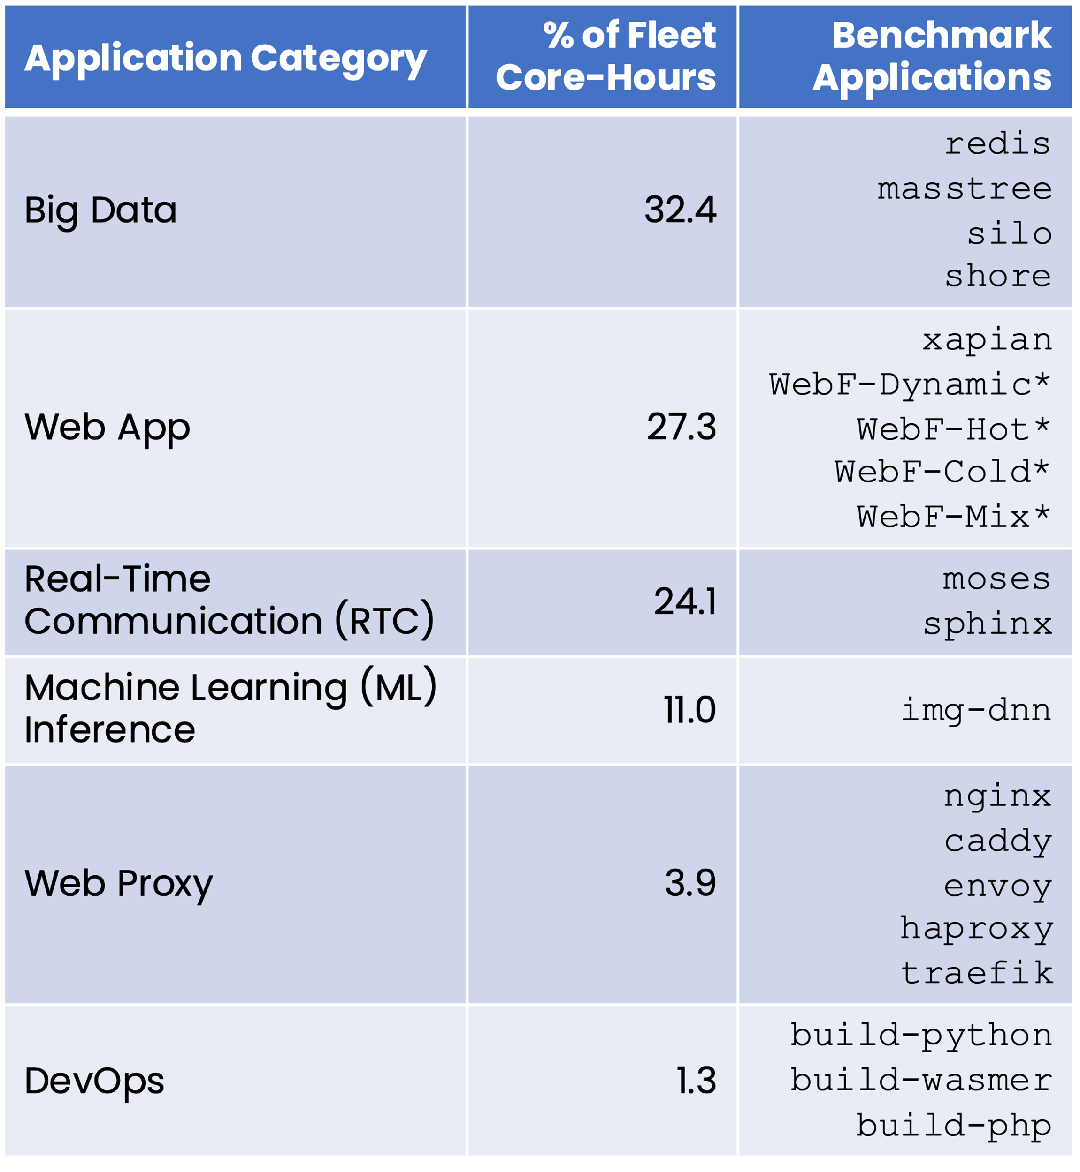
All applications
Taken from a study of all first-party applications at Azure (over 1034 applications)
Categorized from labeled applications and through surveys with application owners
xapian
* internal Azure applications

Slide 44
Performance to Gen3 Baseline

Slide 45
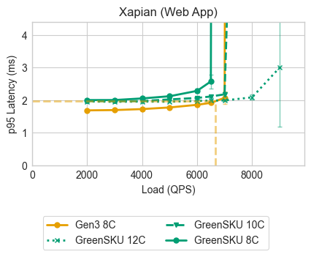
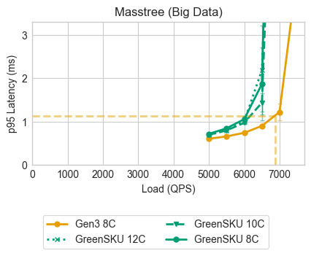
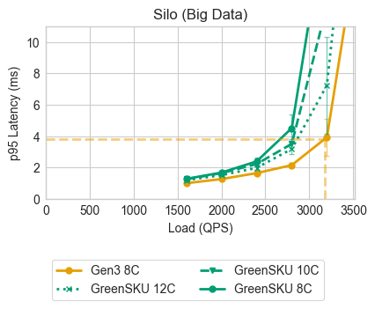
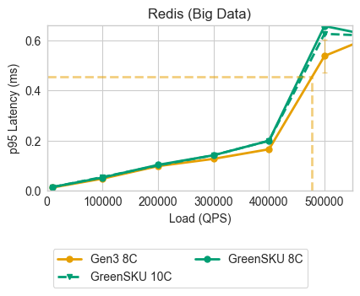
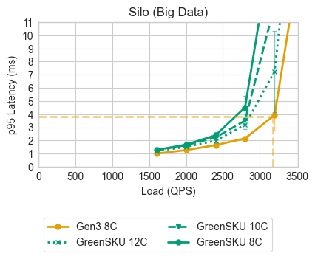

Slide 46
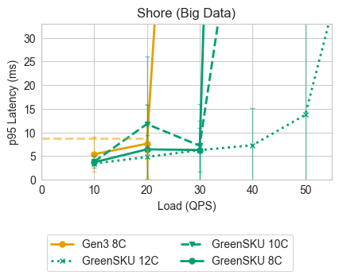
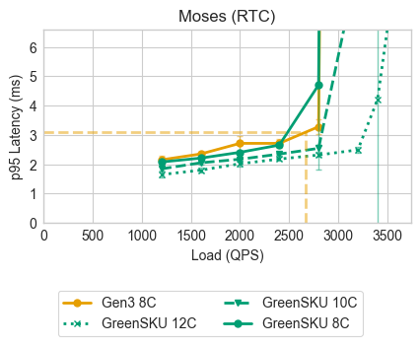
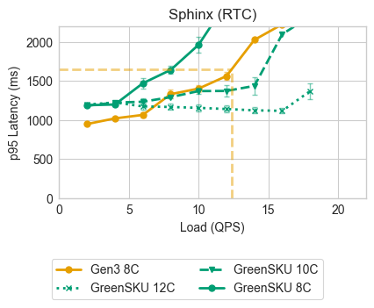
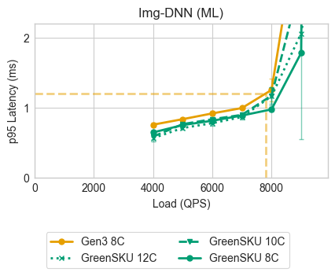

Slide 47
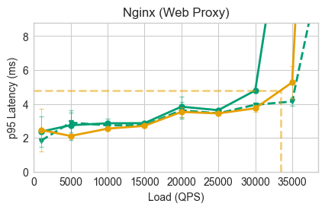
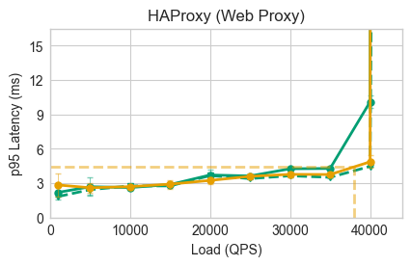
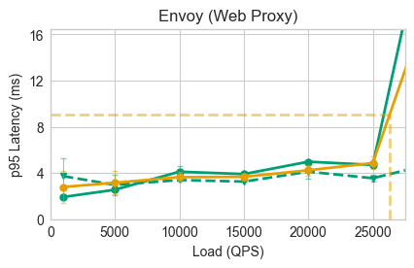
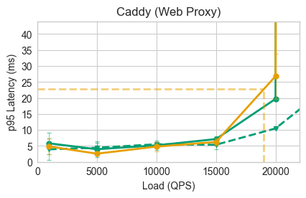
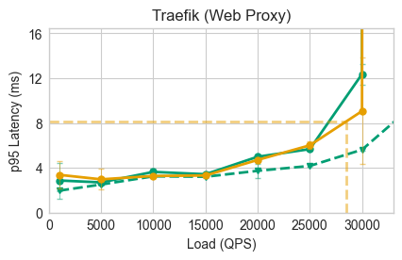

Slide 48
Performance to Gen2 Baseline

Slide 49
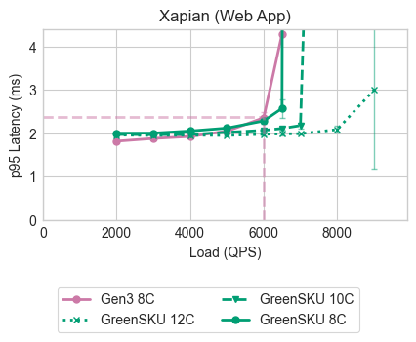
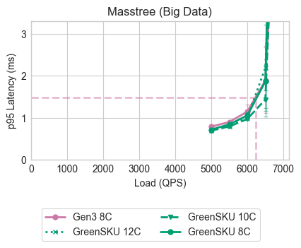
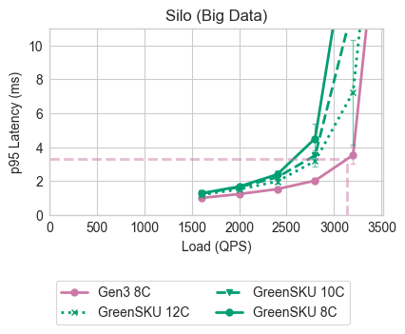
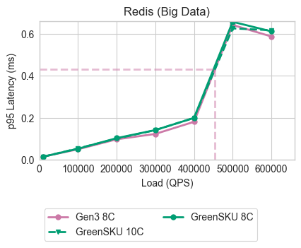
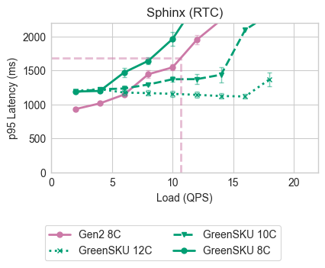

Slide 50
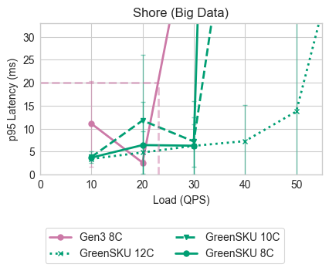
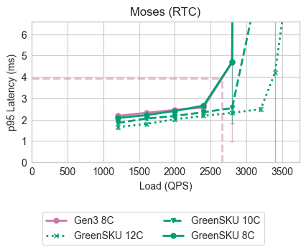

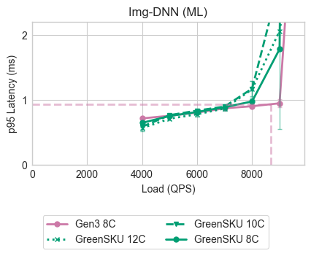

Slide 51
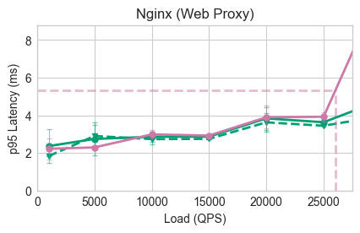
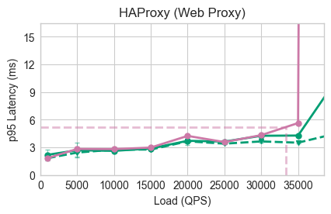
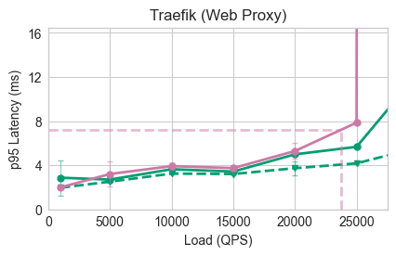
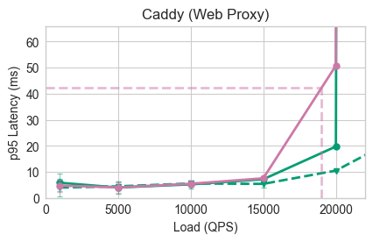
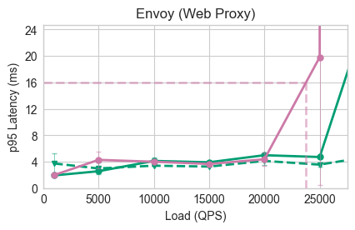

Slide 52
Performance to Gen1 Baseline

Slide 53
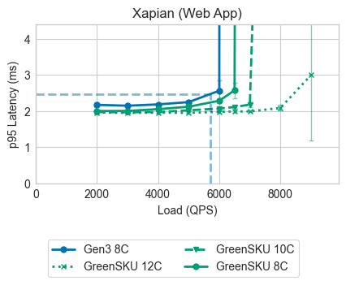
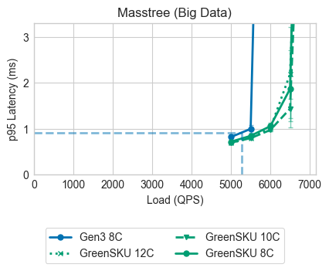
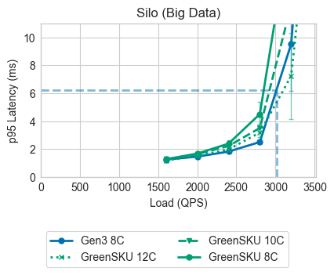
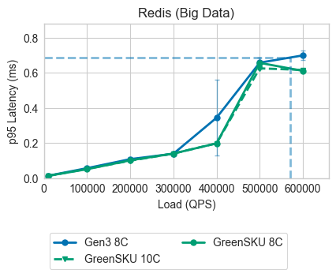
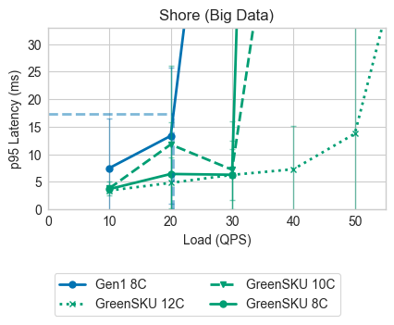

Slide 54

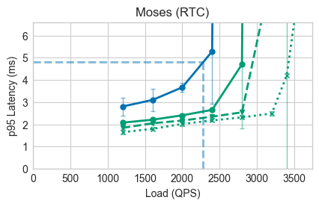
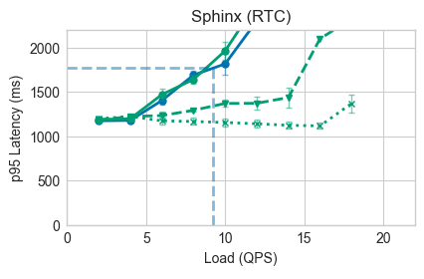
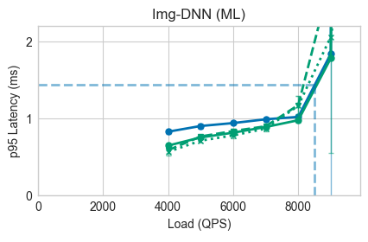

Slide 55
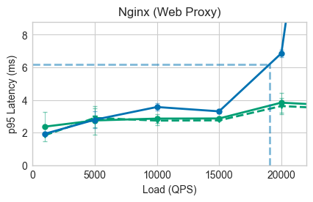
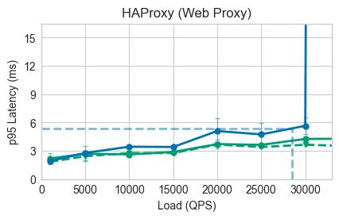
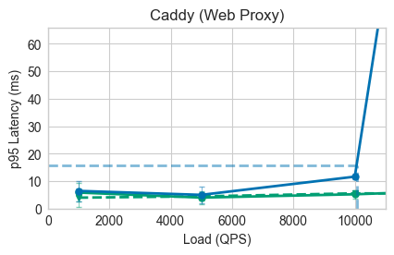
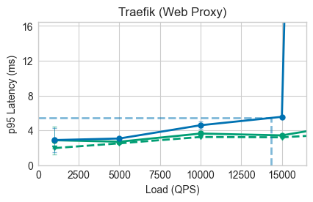
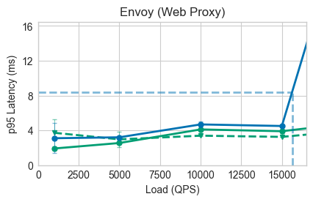

Slide 56
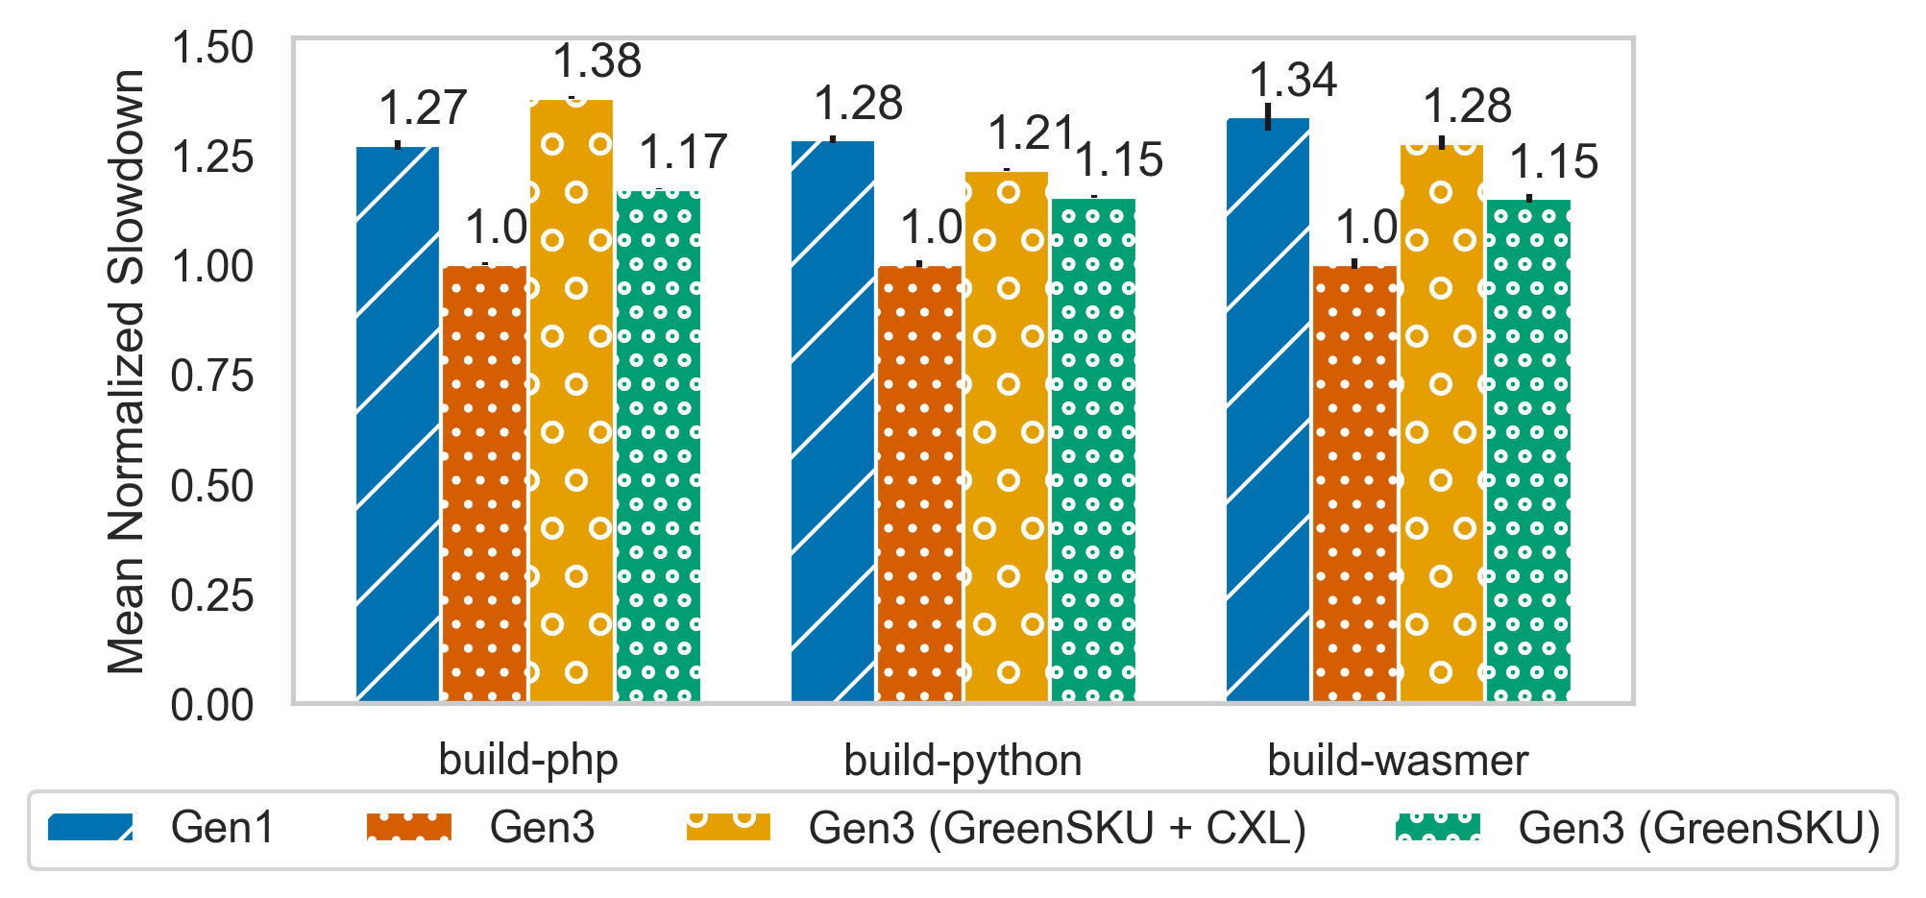
DevOps results/throughput-oriented applications

Slide 57
All scaling factors
Avg. GreenSKU scaling factor relative to baseline…
Category | Gen1 | Gen2 | Gen3
Big Data | 1.12 | 1.12 | 1.25
Web App | 1 | 1.1 | 1.25
RTC | 1 | 1.12 | 1.25
ML Inference | 1 | 1 | 1
Web Proxy | 1 | 1 | 1.15
DevOps | 1 | 1 | 1.25
Notes:
The specs for each server is here. We show a subset of the load vs tail latency sweeps. So load is on the x-axis, 95th percentile tail latency on the y. We show results for the latest Gen3, which sets the SLO, and an older Gen1 (for which there is still high demand in the cloud).
For example, for a Big Data benchmark Masstree, we find that even up to a 12-core scale out on GreenSKU, it cannot achieve the SLO. Meaning that this is not a good candidate to be allocated on a GreenSKU.
However, many applications like Moses can achieve the SLO with minimal scaling, and many more like our ML application actually achieves the SLO while using the same number of cores.

Slide 58

Allocation simulator details
VM Allocation
Simulator
Places VMs with the following preferences:
If a VM is a ”Yes” to GreenSKU adoption, prefer to place on a GreenSKU server
Prefer to place on non-empty servers
Prefer best fit (cores + memory)
VM Trace
(list of VMs with arrival times)
35 3-day production traces
Simulator log
(can be used to replay a cluster allocation and plot packing density data)

Slide 59







How do we implement the VM allocation component?
VM Allocation
VM Request
Cluster-level
Azure
VM Allocator
Simulator
I want to run:
with 4 cores, 8GB memory
on a Gen2 VM
my application,
on a GreenSKU w/ scaling factor =
VM
Azure cloud users
? f
1.2
VM Trace
Web App.
?
Adoption
Big Data
RTC
ML
We capture VM placement decisions and packing behavior using a production simulator

Slide 60

Opportunity for unused memory on CXL

Slide 61

CXL performance

Slide 62
CXL performance mitigations
Pond [Li’23] provides methodologies for using hardware counters to identify applications that can run entirely using CXL memory without a slowdown
Pond also uses a prediction model to identify untouched memory regions that can be placed on CXL
Recent work at Azure develops a multi-tenant memory allocator [Zhong’24] that manages CXL memory as an additional far memory tier beyond local DRAM that results in almost no performance slowdown

Slide 63
Reused SSD performance
We mitigate lower SSD performance using multiple striped RAID sets that each offer more bandwidth and IOPS than the baseline configurations.
As most storage is accessed remotely, disk latency is not a bottleneck nor does it make up the majority of disk access latency.

Slide 64

VM packing effects
Due to high memory embodied, we trade off some core packing density for core density.

Slide 65
Growth buffer
Buffer of servers sized to balance the cost of deploying unused capacity with the risk of opportunity cost of not having extra capacity using a safety stock formula.
We keep a buffer of baseline servers, which handles growth of applications that run on GreenSKUs and baseline servers.
The stock formula is proprietary, so we use a flat 10% overhead of cores that are needed that approximates the growth buffer used in practice.

Slide 66

Maintenance/reliability
DIMMs show no sign of degradation within a 7-year lifespan:
For total server AFR, at a high-level:
We see older DIMMs having similar or better AFR due to being on the right side of the bathtub curve
While there are more components on our GreenSKU, there are roughly proportionally fewer servers needed for the same workloads
Therefore, the repair rate is about the same

Slide 67
Mitigating maintenance overheads
Fail-in-place (FIP) work has recently shown its possible to continue to run servers that have individual components that fail
This effectively reduces the AFR of components that are able to FIP (DIMMs and SSDs)

Slide 68
Maintenance calculation
Model maintenance overhead using Annual Failure Rates (AFRs) which is the number of Out-of-Service (OOS) servers
Use AFRs and FIP effectiveness rate from recent work [Lyu’23]
DIMM AFR = 0.1, SSD AFR = 0.2 (per 100), rest is 2.4
FIP decreases the AFRs by 75%
Baseline server with 12 DIMMs and 6 SSDs → AFR=3
GreenSKU server with 20 DIMMs and 14 SSDs → AFR=3.6
So a 3% vs a 3.6% overhead, which we incorporate into our cluster sizing calculations

Slide 69
How to deal with evolving applications?
Server procurement must be made at discrete intervals, but at each timestep, the current or projected mix of applications can be fed into the framework
Current capacity planning and VM offering must forecast application demand [Eriksen’23] – this can be plugged into our framework
So each server generation has baseline SKUs and GreenSKUs (that may differ over time)

Slide 70
Dealing with black-box VMs and unseen applications
Run-time scheduling systems can be leveraged post-deployment
Auto-scaling
Intelligent scheduling + collocation
Users can also use a similar benchmarking strategy pre-deployment to understand GreenSKU scaling and performance requirements
Our framework is not a run-time system, but assumes that scaling will be used through the methods above

Slide 71
CPU Configurations
 | Bergamo | Rome (Gen 1) | Milan (Gen 2) | Genoa (Gen 3)
Cores | 128 | 64 | 64 | 80
Max core freq. (GHz) | 3.0 | 3.0 | 3.7 | 3.7
LLC size (MiB) | 256 | 256 | 256 | 384
TDP (W) | 350 | 240 | 280 | 300-350

Slide 72
Full GreenSKU server configurations
SKU Config. | # Cores | # DIMMs x DIMM Capacity (GB) | # SSDs x SSD Capacity (TB)
Baseline | 80 | 12 x 64 | 6 x 2
GreenSKU-Dense | 80 | 12 x 96 | 5 x 4
GreenSKU-CXL | 128 | 12 x 64 (CXL) 8 x 32 | 5 x 4
GreenSKU-Full | 128 | 12 x 64 (CXL) 8 x 32 | 2 x 4 (Reused) 12 x 1

